Slide 1
Florida’s Energy Rebate Programs
Florida Department of Agriculture and Consumer Services
Office of Energy

Slide 2
Agenda
FDACS Introductions
Overview of Florida’s Home Energy Rebate Programs
Program Design & Implementation
Timeline & Next Steps
Public Input

Slide 3
Objectives
Engaging Stakeholders to Develop Program
We are prioritizing stakeholder involvement and considering all feedback.
Engaging Stakeholders Throughout the Process
Public engagement will be an ever-present part of Florida's Home Energy Rebate Programs.
Aggregating and Considering all Feedback
We will continue to outline to our partners how feedback will be received and incorporated into Florida’s program design and implementation.

Slide 4
Documentation & Compliance is Critical
Please be mindful that rebates will not be awarded without following proper program guidelines
Still awaiting guidance from the U.S. Department of Energy

Slide 5
Program Details
Whole Home Rebates
Home Efficiency Appliances & Electrification
Whole Home Energy Efficiency-Focused: Based on energy savings targets
Point-of-Sale Program: Eligible items reduced in-store or at the time of service. Based on electrification of home systems
Contractor-Guided Program
DIY or Contractor Installation
Eligible Upgrades can Include: Upgrades must increase energy efficiency by at least 20% Heat pump Heat pump water heater Heat pump dryer Weatherization
Eligible Upgrades can Include: Cooktop, range, or oven, Heat pump clothes dryer Electric service load center Insulation and air sealing Ventilation Electric wiring
Heat Pumps
have additional requirements, including a contractor assessment

Slide 6
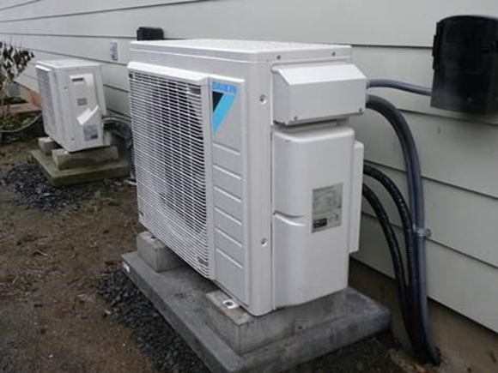
HOMES (50121): Whole Home Efficiency Rebate Program
Performance-based home energy efficiency rebate program
Single-family and multi-family households are eligible
Must demonstrate at least 20% measured energy savings to be eligible for rebates
Higher rebates for households at less than 80% AMI
U.S. DOE requires retroactivity for projects initiated after August 16, 2022
Projects must still meet all program requirements

Slide 7
What is an
Energy Efficiency Upgrade?
Energy efficiency projects ultimately reduce the energy use in a home or building such as:
Energy management updates like installing smart thermostats
Installing more efficient heating or cooling equipment (heat pumps, high-efficiency condensing furnaces, on-demand water heaters, etc.)
Weatherization measures like air sealing and adding insulation

Slide 8
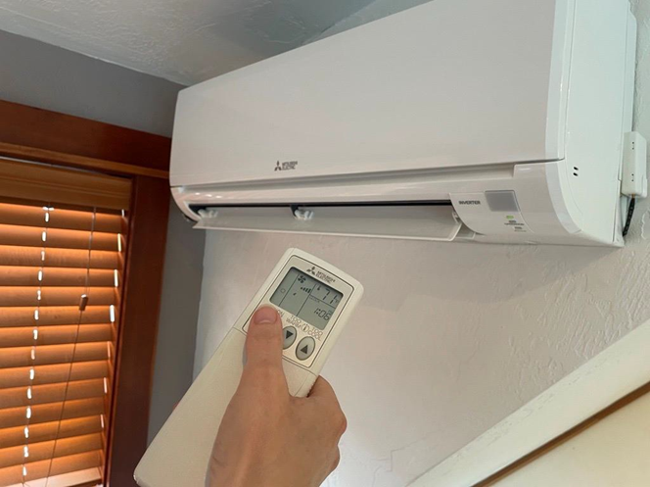
HEAR (50122): Home Electrification and Appliance Rebate Program
Income-restricted, point-of-sale rebate program
Point-of-sale rebate program for installation of high-efficiency electric appliances, associated electric upgrades, as well as insulation and air sealing
For low-income (80% AMI or less) and moderate-income (80% - 150% of AMI income) households only
U.S. DOE does not allow for retroactive rebates within this program

Slide 9
Eligible HEAR Measures
Upgrade Type | Qualified Product | Rebate Amount Not to Exceed
Appliance | Heat Pump Water Heater | $1,750
 | Heat Pump for Space Heating or Cooling | $8,000
 | Electric Stove, Cooktop, Range, Oven, or Heat Pump Clothes Dryer | $840
Building Materials | Electric Load Service Center | $4,000
 | Insulation, Air Sealing, and Ventilation | $1,600
 | Electric Wiring | $2,500
Maximum Rebate: |  | $14,000

Slide 10
Florida’s Energy Rebate Programs Overview
HOMES and HEAR may not be combined for the same, single upgrade and rebates must not exceed total project cost
Separate applications and supporting documentation must be submitted for each program

Slide 11
Additional Elements
Combining with other federal and state programs and incentives are encouraged
Limitations may apply
Total rebates cannot exceed the cost of the measure or the appliance
U.S. DOE continues to develop guidance materials for fund braiding

Slide 12
Area Median Income
Calculated annually by the Department of Housing and Urban Development
Differs by state
Accounts for household income relative to the number of people in the household
Categorical eligibility for enrollment in existing federal assistance programs within statutory limits

Slide 13
80% Area
Median Income (AMI)
County | 1 Person | 2 Person | 3 Person | 4 Person
 | Household | Household | Household | Household
Fort Lauderdale | $53,800 | $61,450 | $69,150 | $76,800
Pensacola | $45,800 | $52,400 | $58,950 | $65,450
Jacksonville | $49,600 | $56,650 | $63,750 | $70,800
Tampa | $48,650 | $55,600 | $62,550 | $69,500
Fort Myers | $47,700 | $64,500 | $61,300 | $68,100
Tallahassee | $48,150 | $55,000 | $61,900 | $68,750
Orlando | $49,150 | $56,200 | $63,200 | $70,200
Wauchula | $35,950 | $41,100 | $46,250 | $51,350
Palatka | $35,950 | $41,100 | $46,250 | $51,350

Slide 14
HOMES Rebate Limitations
Eligible Rebate Recipient | Income Level | Rebate Amount Not to Exceed
LMI Household or Eligible Entity Representative Representing LMI Household | Less than 80% AMI | 80% of Qualified Project Cost
 | Above 80% AMI | 50% of Qualified Project Cost
Owner of Multifamily Building or Eligible Entity Representative Representing Owner of Multifamily Building | At least 50% of Residents with Income Less than 80% AMI | 80% of Qualified Project Cost
 | At least 50% of Residents with Income above 80% AMI | 50% of Qualified Project Cost
Disclaimer: Florida has not finalized its rebate limitations.
Florida reserves the right to modify limitations within statutory boundaries and with prior approval from U.S. DOE.

Slide 15
Measured Savings
Projects must achieve a measured energy savings of 15% across a portfolio of homes to qualify for rebates
Measured requires 12 months of pre-upgrade data per kWh for each participating household and at least 9 months of post-upgrade data per kWh.
Payment rate is per kWh and equals $2,000 for a 20% reduction of energy use for the average home in the state
Rates double for low- and moderate-income individuals

Slide 16
Florida Energy Rebates Program: Anticipated Timeline and Next Steps
Continue gathering feedback from stakeholders and develop program design
Procure an eligible and experienced vendor for planning and implementation of the program
Submit application to the U.S. Department of Energy
Prepare for our anticipated launch in early 2025*
*Program timelines are contingent upon U.S. DOE approvals and release of funding

Slide 17
Feedback
Use the following QR code to access the survey and submit your feedback. Additionally, you may submit questions, comments, and feedback via our email – FLEnergyRebates@FDACS.gov
Check FDACS.gov/FLEnergyRebates for additional information

Slide 18
Public Webinar Survey
≈ 3 minutes
We value your feedback!
Please scan the QR code and take 3 minutes to complete our survey. This survey will remain open until July 1st.
https://FDACS.gov/EnergySurvey

